Slide 1
PRIMs tutorial Unit 1
Niels Taatgen

Slide 2
Where to get PRIMs?
PRIMs is an application written in Swift
Source code is at:
https://github.com/ntaatgen/PRIMs
Tutorial materials are at:
https://github.com/ntaatgen/PRIMs-Tutorial
This includes the compiled application

Slide 3
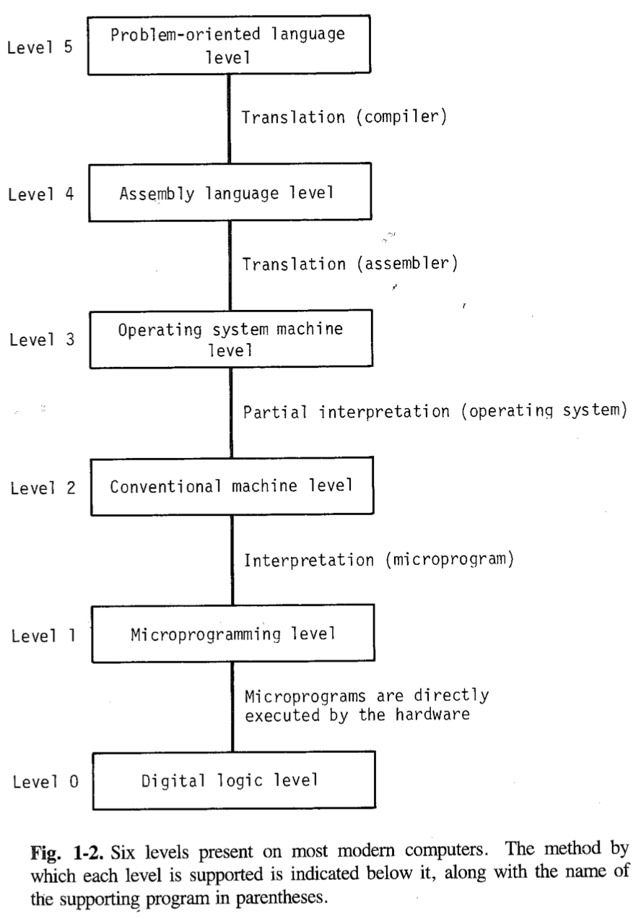
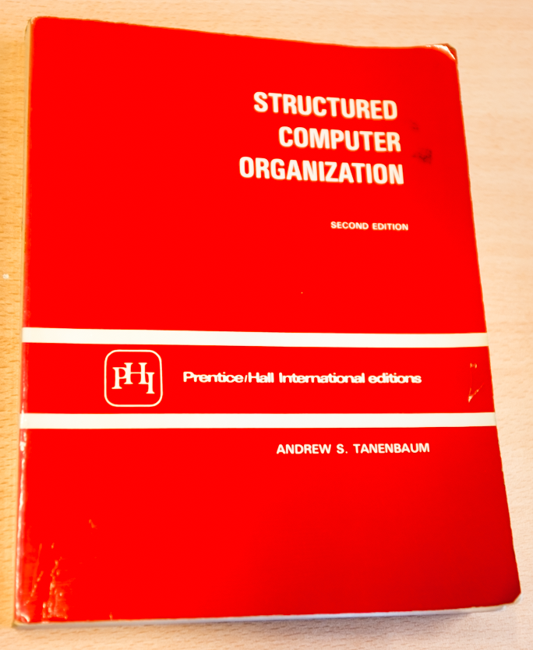
Notes:
Lower levels are physics, higher levels have “meaning”.

Slide 4


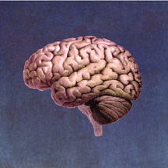
Intelligence
Direct
Expla- nation
Cognitive Architecture
Human Brain
(100 billion cells)
Notes:
Psychology: people with a high IQ have a high WM capacity

Slide 5
Levels of abstraction for Cognition (Newell)
Time Units | System | World theory
Months |  | Social Band
Weeks
Days
Hours | Task | Rational Band
10 min | Task
minutes | Task
10 sec | Unit Task | Cognitive Band
1 sec | Operations
100 msec | Deliberate act
10 msec | Neural circuit | Biological Band
1 msec | Neuron
100 μsec | Organelle

Slide 6
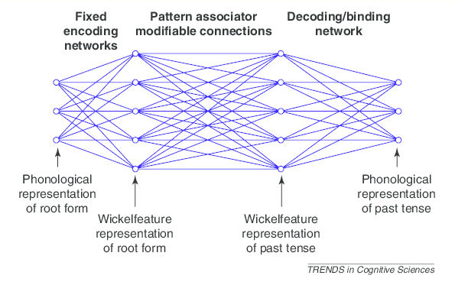
Operating at the wrong level

Slide 7
Production Rules/Operators

Slide 8
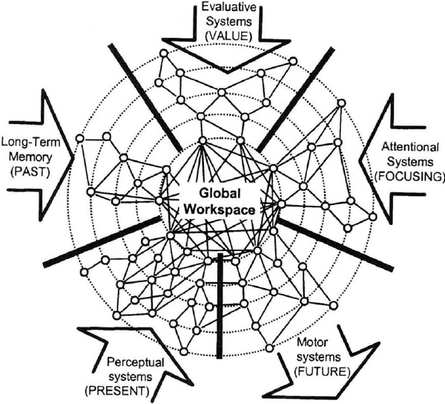
Assumption: Modular structure with a Global Workspace (Baars & Dehaene)

Slide 9
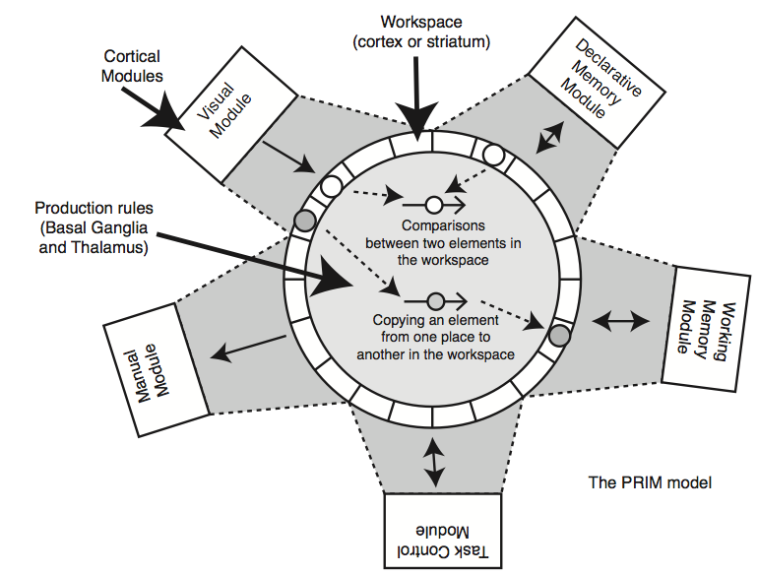
Our version

Slide 10
The neuron level
Cognitive modules are all over the brain (mainly cortex)
They each contribute to the workspace (the interface area, we will call those buffers)
Operations within the workspace are carried out by the Basal Ganglia

Slide 11
Cortical Area: Perception
Cortical Area: Memory
Cortical Area: Action
Basal Ganglia
Thalamus

Slide 12
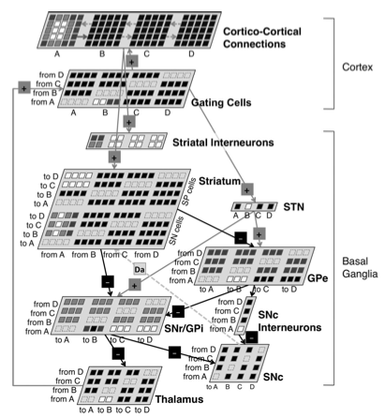
Andrea Stocco’s model of the Basal Ganglia

Slide 13
But what does it do?
Cortex
Visual
LTM
WM
Control
Manual
...
...
Basal Ganglia
Thalamus

Slide 14
Example: Aural-Vocal task
You hear a tone with a certain pitch (low-medium-high)
You have to say as quickly as possible the word associated with that pitch
Low -> One
Medium -> Two
High -> Three

Slide 15
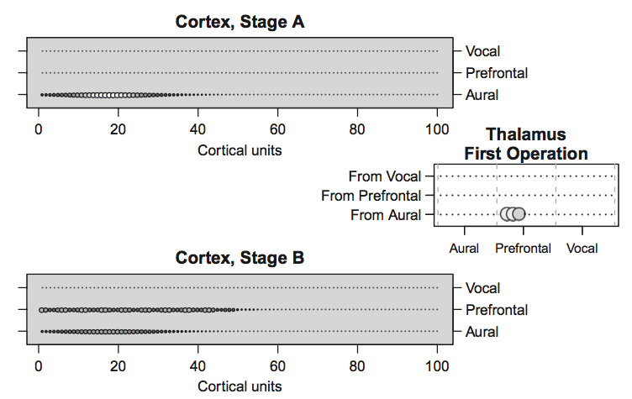

Slide 16
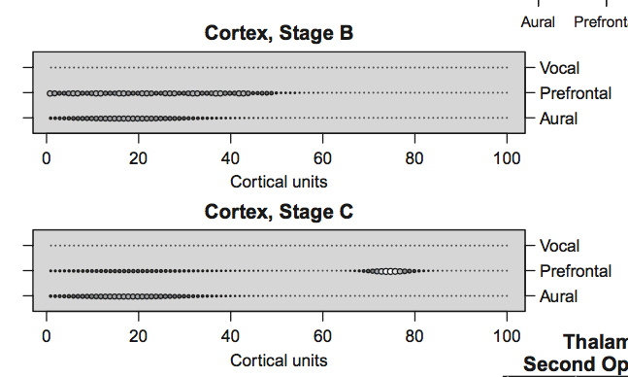

Slide 17
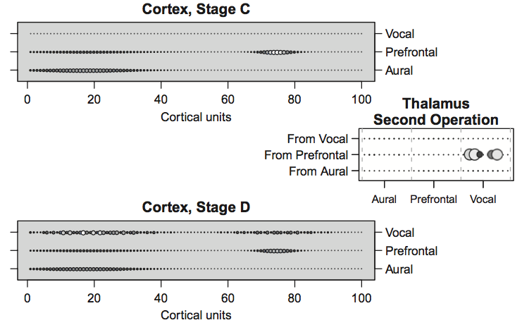

Slide 18
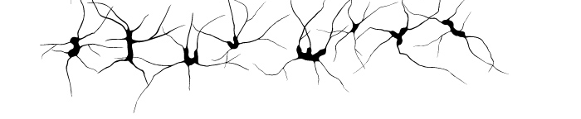
Stocco’s BG model: a lot of machinery for something simple
Neurons
“transistors”
PRIMs
“microprogramming”

Slide 19
Cortex
Visual
LTM
WM
Control
Action
...
...
Basal Ganglia
Thalamus
V2 = RT1
RT2 -> AC3

Slide 20
Let us look at the Aural-Vocal task again
Input
LTM
WM
Control
Action
Low Pitch
V1 <> nil
V1 -> RT2
Associate
Associate -> RT1
“One”
Say
RT3 <> nil
RT3 -> AC2
Say -> AC1

Slide 21
From PRIMs to operators
PRIMs
“microprogramming”
Operators
“machine language”
Complex tasks require many elementary steps that are carried out in parallel and in sequence

Slide 22
Aural-Vocal task has two operators
V1 <> nil
V1 -> RT2
RT3 <> nil
RT3 -> AC2
Associate -> RT1
Say -> AC1

Slide 23
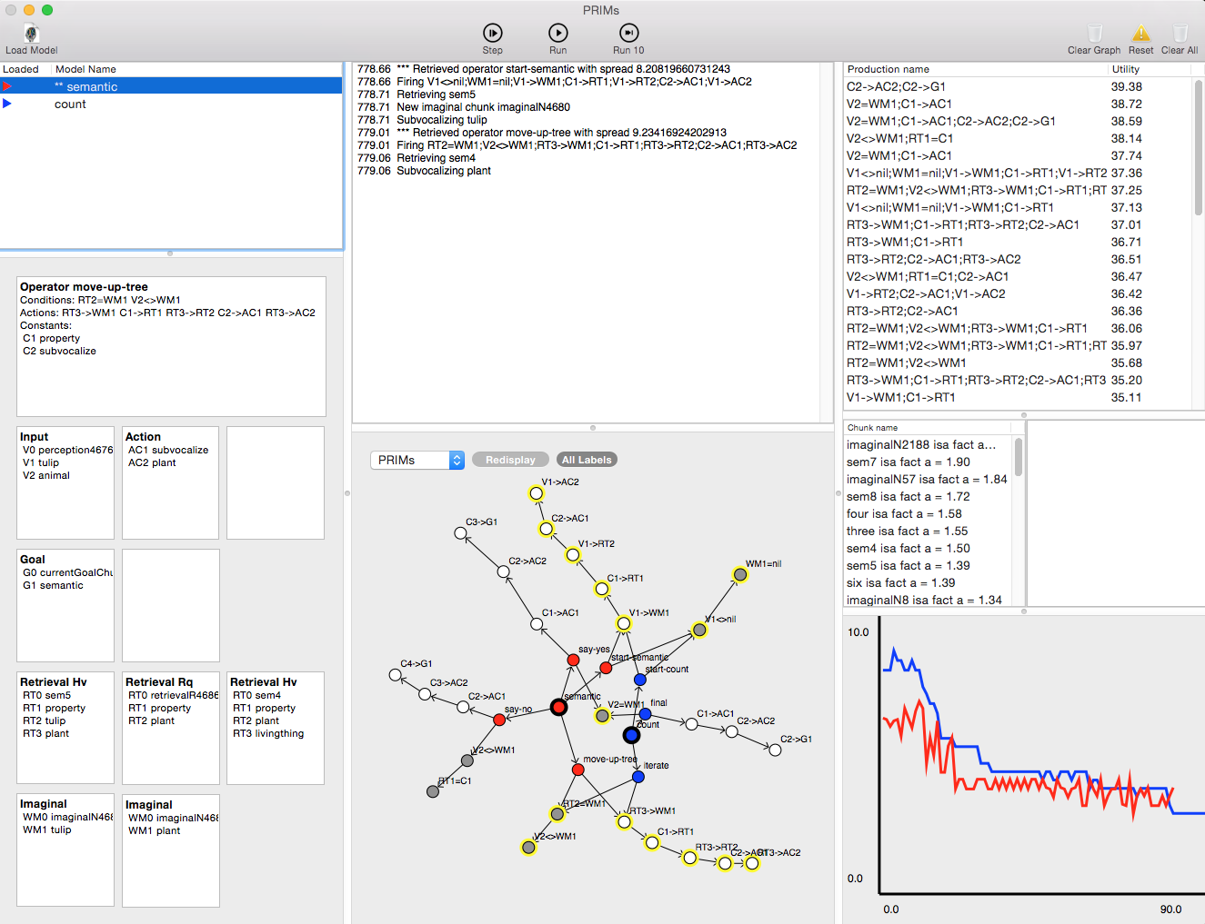
New implementation

Slide 24
Anatomy of Count
operator start-count {
V1 <> nil // There has to be a visual
WM1 = nil // Imaginal should be empty
==>
V1 -> WM1 // Copy the start number to imaginal slot 1
count-fact -> RT1 // Start retrieving the next number
V1 -> RT2
say -> AC1 // Say the current number
V1 -> AC2
}

Slide 25
Actual chunk representation
start-count
isa operator
slot1 count-fact
slot2 say
condition V1<>nil;WM1=nil
action V1->WM1;C1->RT1;V1->RT2;C2->AC1;V1->AC2

Slide 26
What are PRIMs’ buffers?
V (Visual): input from the task
WM (Working Memory)
G (Goals)
RT (Declarative Memory)
AC (Action)
C (Constants): specific values for an operator
T (Temporal): used for time perception

Slide 27
Two more operators to make it work
operator iterate {
RT2 = WM1
V2 <> WM1
==>
RT3 -> WM1
count-fact -> RT1
RT3 -> RT2
say -> AC1
RT3 ->AC2
}
operator final {
V2 = WM1
==>
say -> AC1
stop -> AC2
stop -> G1
}

Slide 28
Declaration of the Task
define task count {
initial-skills: (count)
default-activation: 1.0
ol: t
rt: -2.0
lf: 0.2
default-operator-self-assoc: 0.0
}

Slide 29
PRIMs associations
Start-Count
Goal
Count
Daydream
Iterate
Final

Slide 30
Connect operators to skills
define skill count {
... Operator definitions ...
}

Slide 31
What else do we need?
define facts {
(cf1 count-fact one two)
(cf2 count-fact two three)
(cf3 count-fact three four)
(cf4 count-fact four five)
(cf5 count-fact five six)
}

Slide 32
(cf1 count-fact one two)
cf1
isa fact
slot1 count-fact
slot2 one
slot3 two

Slide 33
Have to define interaction with the task
define script {
digits = ["one","two","three","four","five","six","seven",
"eight","nine","ten"]
start = random(3)
end = start + 1 + random(3)
print("Counting from",digits[start],"to",digits[end])
screen(digits[start],digits[end])
run-until-action("say","stop")
issue-reward()
trial-end()
}

Slide 34
Assignment
Implement addition
Two versions
the “standard” (ACT-R unit 1) version
Adding using fingers as external memory

